Slide 1
Group 3
Roll No 15 – 21
River Lawrence – River Rhine

Slide 2
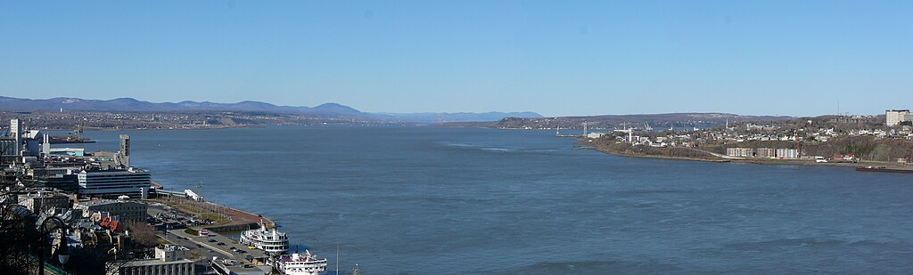
River Lawrance
Roll NO 19,15
The St. Lawrence River is a massive North American waterway that connects the Great Lakes to the Atlantic Ocean. It is a vital commercial route and forms part of the St. Lawrence Seaway, running through parts of Canada and the United States.

Slide 3
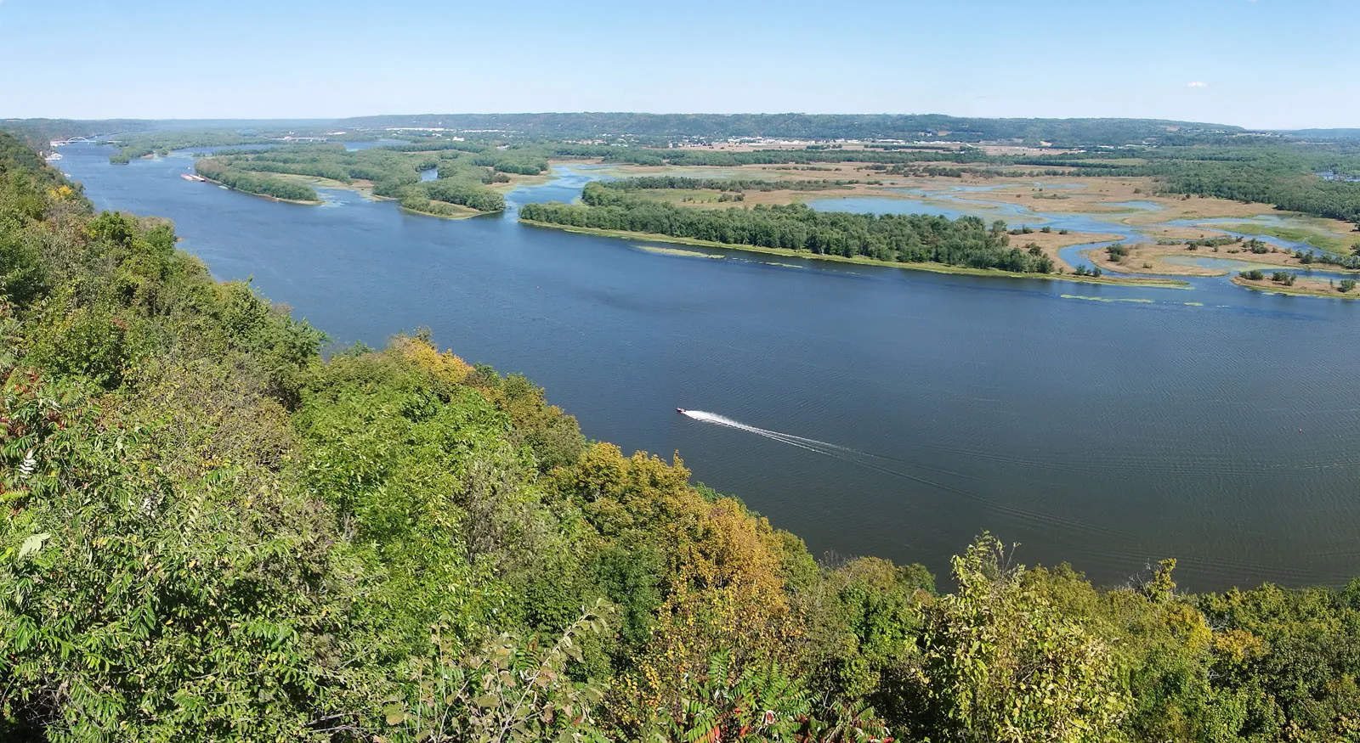

Roll NO 17
river
Mississippi
The Mississippi River is the second-longest river in the United States. It begins it journey from Lake Itasca and empties in the Gulf of Mexico/America.

Slide 4
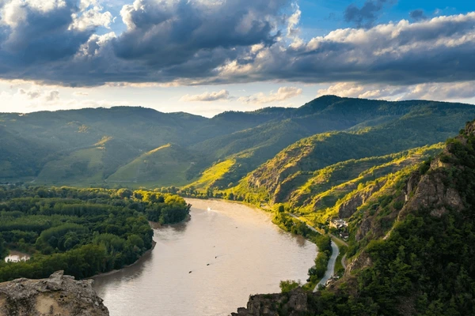
River
Danube
Roll NO 16,20
The Danube is a river in Europe, the second-longest after the Volga in Russia. It flows through Central and Southeastern Europe . It starts from Western Germany and flows into the Black Sea.

Slide 5
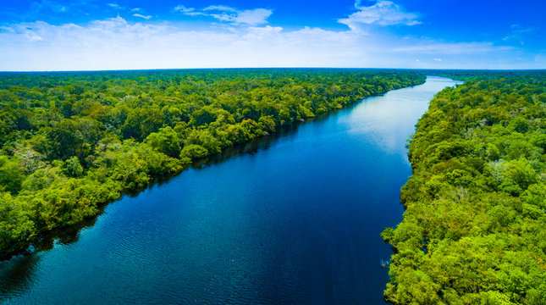
Roll NO 21
river
amazon
The Amazon river is the world’s second longest river at 3,980 miles. It contributes one fifth of all the water poured into the world’s oceans by the rivers.

Slide 6
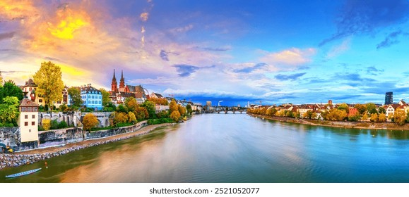
river Rhine
Roll NO 18
The Rhine is one of the major rivers of Europe. The river begins in the Swiss canton of Graubünden in the southeastern Swiss Alps.

